Slide 1
C++ Basic Constructs

Slide 2
Teaching
Class Schedule
Getting to know your Instructor and TA (Naman)
Doubts
Slack Channel
WhatsApp Group
Contribution
Github Repository (https://github.com/sachin235/CP-DSAlgo_August2020)
Leetcode (https://leetcode.com/problemset/top-100-liked-questions/)
Additional
C++ Tutorial
C++ References

Slide 3
Functions
OOPS - Classes
Lambda Expressions (*)
References
Pointers
Exception Handling
Modules (*)
Generic programming a.k.a Templates (*)
Multithreading (*)

Slide 4
Functions
What is function?
Declaration & Definition
Parameters & Arguments
Returning multiple values from function
Function Overloading
Default Parameters
Pass by Value & Pass by Reference

Slide 5
Functions
A function is a block of code that performs some operation.
A function can also define input parameters that enable calling function can pass in the arguments which can be vital in performing the operations.
Functions are useful for encapsulating common operations in a single reusable block, ideally with a name that clearly describes what the function does.

Slide 6
Function Declaration & Definition
Declaration
Function name : which must begin with a letter or underscore and cannot contain spaces and special characters
Parameter list : a brace delimited, comma-separated set of zero or more parameters that specify the type and optionally a local name by which the values may be accessed inside the function body.
Return type : which specifies the type of the value that the function returns, or void if no value is returned
Definition
A function definition consists of the declaration + function body, enclosed in curly braces

Slide 7
Function Parameters vs arguments
Parameters: Comma separated list of zero or more types, each of which has a name by which it can be accessed inside the function body.
Arguments: When a method is called, the arguments are the type compatible data you pass into the method's parameters.
void foo(string name) { } … string studentName = "Alpha"; foo(studentName);

Slide 8
Returning multiple values from a function

Slide 9
Function Overloading
Two functions declared in the same scope can have the same name if the number and/or type of arguments passed is different.
These functions having the same name but different arguments are known as overloaded functions.
Functions can not be overloaded if they differ only in the return type.

Slide 10
Function Default Arguments
A default argument is a value provided in a function declaration that is automatically assigned by the compiler if the caller of the function doesn't provide a value for the argument with a default value.
Default arguments are important because in many cases, functions have arguments that are used so infrequently that a default value would suffice.
To address this, the default-argument facility allows for specifying only those arguments to a function that are meaningful in a given call.
Once default value is used for an argument in function definition, all subsequent arguments to it must have default value. It can also be stated as default arguments are assigned from right to left.

Slide 11
Pass by Value vs Pass by Reference
When a function is called, the arguments in a function can be passed by value or passed by reference.
Callee is a function called by another and the caller is a function that calls another function (the callee).
The values that are passed in the function call are called the actual parameters.
The values received by the function (when it is called ) are called the formal parameters.

Slide 12
Pass by Value
Pass by value means that a copy of the actual parameter value is made in memory, i.e. the caller and callee have two independent variables with the same value. If the callee modifies the parameter value, the effect is not visible to the caller.
Overview:
Passes an argument by value.
Callee does not have any access to the underlying element in the calling code.
A copy of the data is sent to the callee.
Changes made to the passed variable do not affect the actual value.

Slide 13
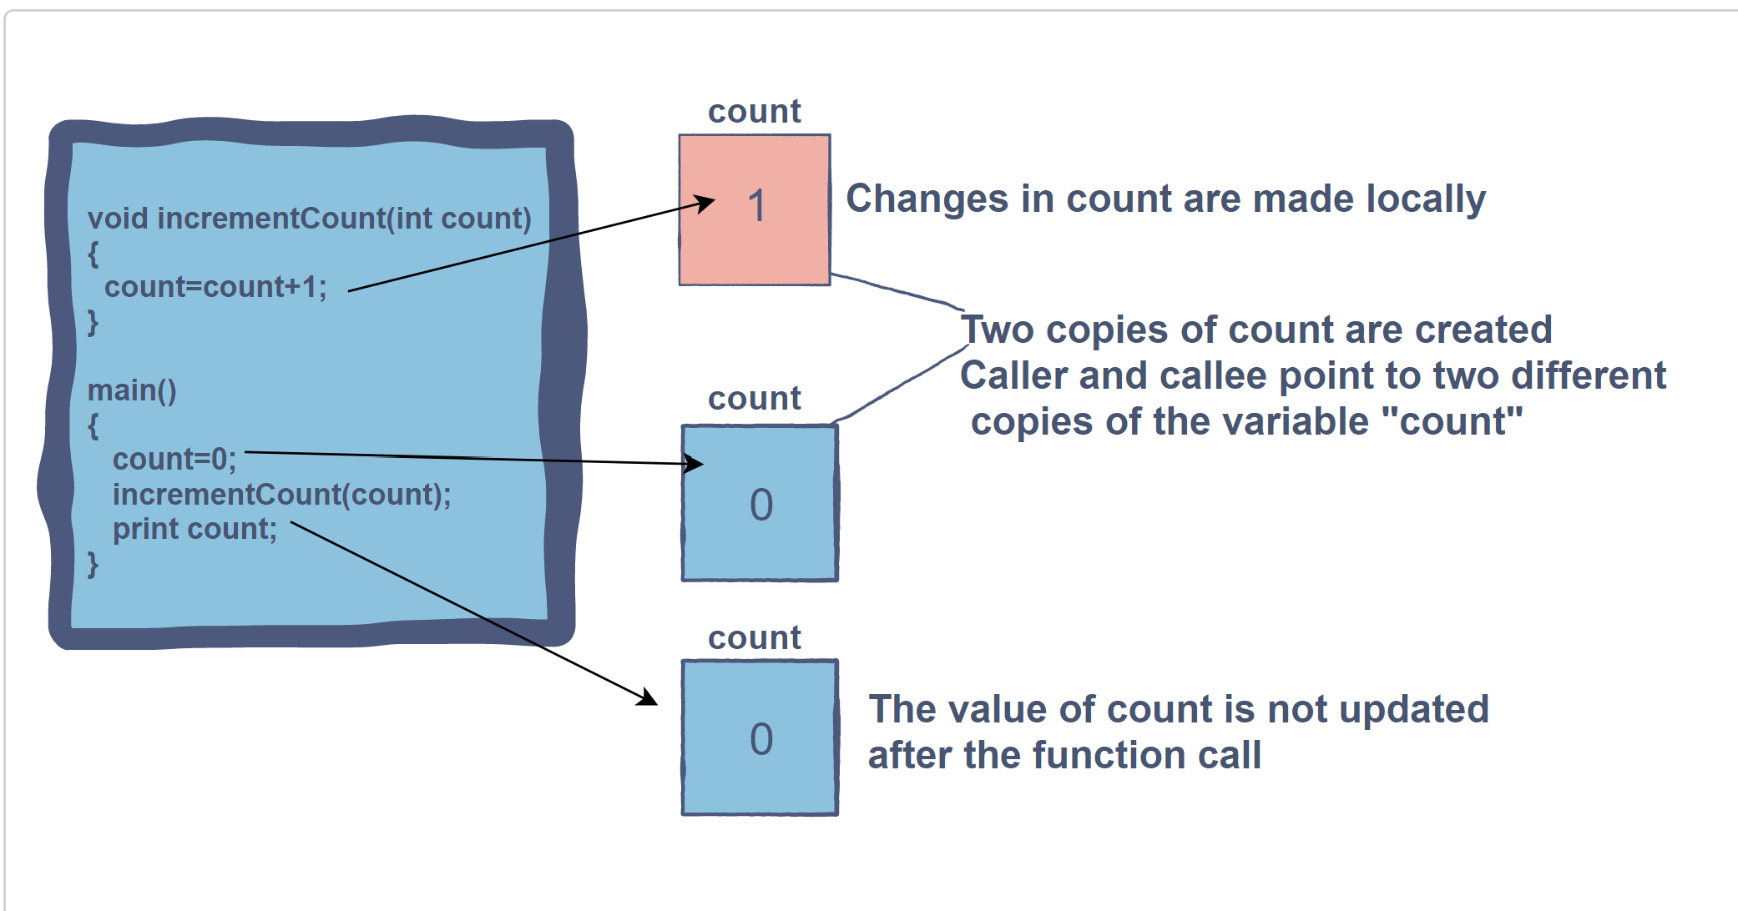
Pass by Value

Slide 14
Pass by Reference
Pass by reference (also called pass by address) means to pass the reference of an argument in the calling function to the corresponding formal parameter of the called function so that a copy of the address of the actual parameter is made in memory, i.e. the caller and the callee use the same variable for the parameter. If the callee modifies the parameter variable, the effect is visible to the caller’s variable.
Overview:
Passes an argument by reference.
Callee gives a direct reference to the programming element in the calling code.
The memory address of the stored data is passed.
Changes to the value have an effect on the original data.

Slide 15
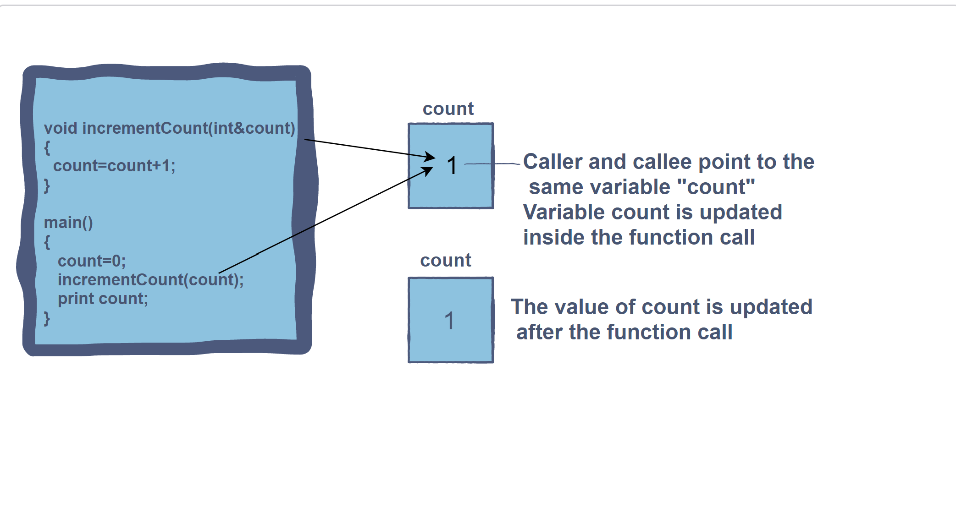
Pass by Reference

Slide 16
Pointers
& References
Dynamic memory allocation
Stack vs Heap
What is pointer?
What are references?
Pointer arithmetics
new and delete operators
Smart pointer (*)
auto_ptr, unique_ptr, shared_ptr and weak_ptr (*)

Slide 17
Pointers & References
Pointers are variables which stores the address of another variable.
When we allocate memory to a variable, pointer points to the address of the variable.
Unary operator ( * ) is used to declare a variable and it returns the address of the allocated memory.
The following is the syntax of pointers.
datatype *variable_name;
A reference variable is an alias, that is, another name for an already existing variable. Once a reference is initialized with a variable, either the variable name or the reference name may be used to refer to the variable.
int a = 30;
int& r = a;

Slide 18
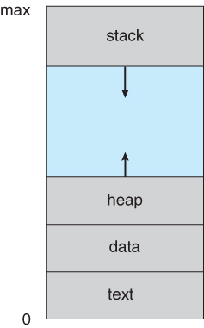
Process Memory Diagram
The text section comprises the compiled program code, read in from non-volatile storage when the program is launched.
The data section stores global and static variables, allocated and initialized prior to executing main.
The heap is used for dynamic memory allocation, and is managed via calls to new, delete, malloc, free, etc.
The stack is used for local variables. Space on the stack is reserved for local variables when they are declared ( at function entrance or elsewhere, depending on the language ), and the space is freed up when the variables go out of scope. Note that the stack is also used for function return values, and the exact mechanisms of stack management may be language specific.
Note that the stack and the heap start at opposite ends of the process's free space and grow towards each other. If they should ever meet, then either a stack overflow error will occur, or else a call to new or malloc will fail due to insufficient memory available.

Slide 19
Object
Oriented
Programming
What is a Class?
Access Modifiers - public, private, and protected
Constructor and Destructor
Inheritance, Overloading, Polymorphism, Overriding
Friend class and function, Local class, Nested Class
this pointer

Slide 20
Template
What is template (generic programming)?
Class Template
Function Template

Slide 21
Templates in C++
Templates are the mechanism by which C++ implements the generic concept. Simply, they allow you to pass data type as a parameter so that you don’t need to write the same code for different data types.
A powerful feature of C++ is that you can make ​template classes​ which are ​classes ​that can have ​members ​of the ​generic​ type, i.e., members that use template parameters as types.

Slide 22
Exception Handling
What is Exception Handling?
Try - Catch - Throw
Unhandled Exception
Exceptions vs Assertions
Debugging (IMPORTANT)

Slide 23
Data types & Modifiers
Boolean (bool)
Character (char)
Integer (int)
Floating Point (float)
Double Floating Point (double)
No Value (void)
Data Type Modifier
signed
unsigned
short
long

Slide 24
Data types & Modifiers
unsigned char (default) | = 1 byte = 0 - 255
int | = 4 byte = -2,147,483,648 to 2,147,483,647
unsigned int | = 4 byte = 0 to 4,294,967,295
long int | = 4 byte = -2,147,483,648 to 2,147,483,647
long long int | = 8 bytes = -9,223,372,036,854,775,808 to 9,223,372,036,854,775,807
unsigned long long int | = 8 bytes = 0 to 18,446,744,073,709,551,615
float | = 4 bytes = 3.4E +/- 38 (7 digits)
double | = 8 bytes = 1.7E +/- 308 (15 digits)

Slide 25
Thanks

